Slide 1
Pitch Guidance Template
Thursday July 11

Slide 2
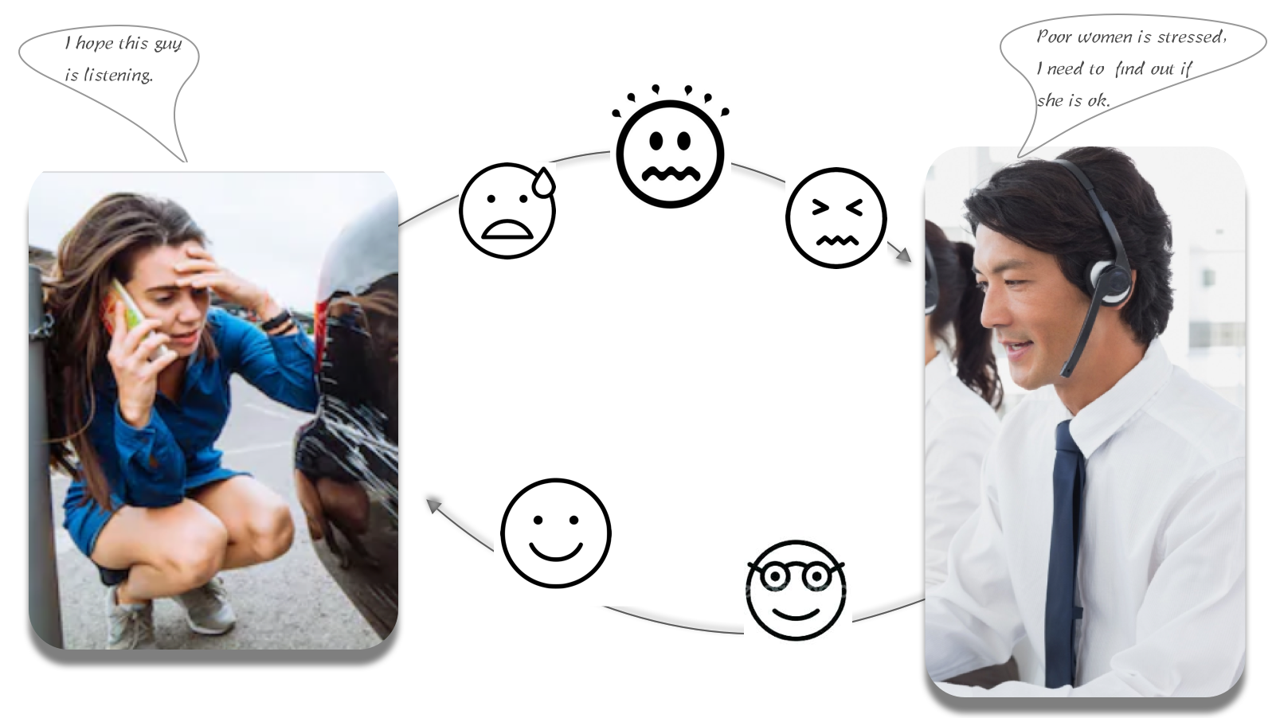
Notes:
https://ozonetel.com/blog/how-speech-analytics-can-measure-improve-customer-experience-in-your-call-center/

Slide 3
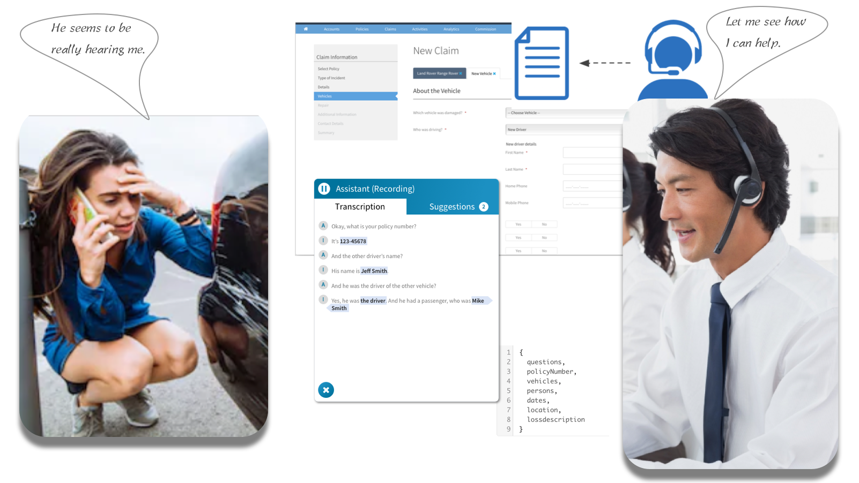
Notes:
https://ozonetel.com/blog/how-speech-analytics-can-measure-improve-customer-experience-in-your-call-center/

Slide 4
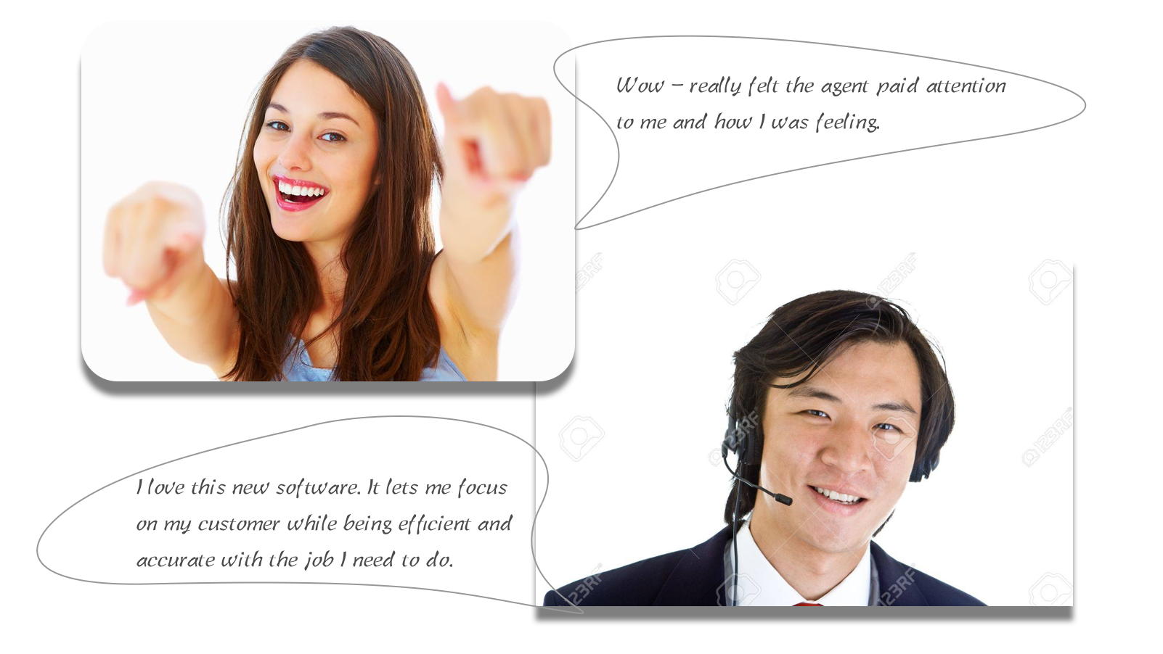
Notes:
https://ozonetel.com/blog/how-speech-analytics-can-measure-improve-customer-experience-in-your-call-center/

Slide 5

The Solution – extended use cases (will include Terese’s work.)
Use cases:
Guidewire Assistant – Hackathon Participation.
Capture interaction history automatically for compliance (Metlife)
Configurable automated cheat sheet for better productivity (Amica)
Risk Surveyor’s Assistant / Claim Adjuster’s Assistant – Capture reality to compare and validate the information captured previously.
Claim adjuster’s Assistant
Automated note capture – Save as a note
Notes:
https://ozonetel.com/blog/how-speech-analytics-can-measure-improve-customer-experience-in-your-call-center/

Slide 6






About the Team
Keep all the Emoticons your team went through during the Hackathon. (Delete the rest)
Demo Status | Green or Red
Team Size (Number of people)
Team Composition: Keep all that applies and delete the rest. | DEV | UX | PM | QA | DOC | …
Team Location Select one that applies | Co-located | Distributed
Looking Back: We hope your team had a moment to reflect after your hackathon was over.
One thing your team learned from your mistakes
One thing that really worked well for your team
Rate the overall experience with the hackathon on the day
Happy
Proud
Sad
Fear
Worried
Anger
Upset

Slide 7

Evaluation Criteria
Keep these evaluation criteria in mind while giving your demo.
Working Demo
30%
The focus of this Hackathon is results which prove/validate a new way of working. We are not looking for idea generation. A winning project will deliver clarity through a working demo that identifies a key issue that is being resolved.
Alignment with Theme
25%
The investment in this hackathon is being pursued to help our organization realize a very targeted outcome. Winning ideas will be those that get us closer to this goal.
Customer Centricity
20%
Think about the products you love. Why do you love them? Because they were designed specifically for you. For this hackathon, the winning projects will demonstrate customer empathy and focus on improving their experience. While there are 100's of low-value tasks that could be automated, the winning project should targeted the one that has the highest customer value.
Team Presentation
10%
The winning team will exhibit the ability to communicate what problem they were looking to solve, what their focus was, what they learned and accomplished and how their product is likely to evolve, should more funding be available to the team.
Diversity of Team
10%
Winning team's composition will be diverse and preferably distributed. They would have gone beyond their comfort zone of working with their existing team.
Uniqueness of Solution
5%
While there are many ways to solve a problem, the winning team would have challenged every assumption and explored multiple alternatives to discover a unique way to solve the problem.
This slide is to help you prioritize. Don’t include this in your pitch

Slide 8


The Problem
Focus for an Agent/Rep should be on the quality of the exchange with the customer. Attention to the emotions and mental state of the customer, particularly in potentially stressful situations such as an accident which has just happened, increases the opportunity to create a positive outcome. When the agent’s attention is split between the accurate capture (and file) of the information they can’t fully focus on the experience of the customer. This capture and filing is critical but also mundane and repetitive for the agent.
The Solution
Imagine the automation of not only voice to text, but an intelligent system that is configured to tag the meta-data of the captured text. Then, imagine how much more quickly an agent could fill out any form fields with a single click or two, or drag and drop. When the agent builds confidence that he/she will meet (and exceed) work expectations because they can increase both accuracy and efficiency all the while creating moments of delight with the end user. What is left for both the agent and the customer is an impression, an ‘after taste’, on the experience of satisfaction as well as an increase in the confidence of Guidewire’s products by carriers.
a
Hackathon Scope
Now narrow it down to the hackathon. Show the Demo: what you picked and why you chose it? Why is the accomplishment significant? A few lines on what needs to be done next. It should help make a case on what benefit could be achieved if further investment was made in this project.
We need Yeshvant’s and Bharat’s comments here
Notes:
https://ozonetel.com/blog/how-speech-analytics-can-measure-improve-customer-experience-in-your-call-center/

Slide 9
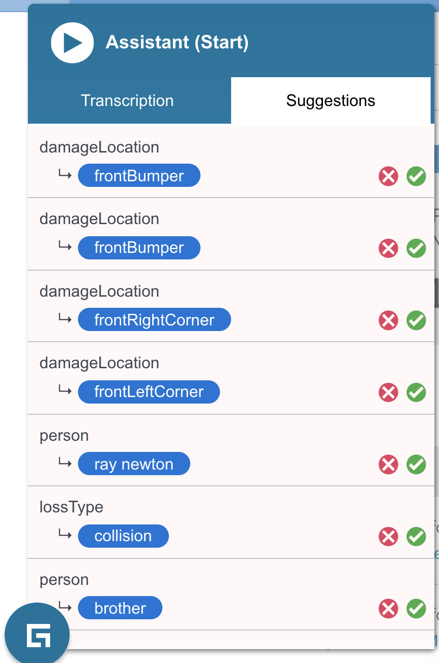
Technology
Voice to Text (Google Voice to Text API)
Natural Language Analysis of text to get intent of the conversation (Google NLP and Compromise.Cool)
Providing appropriate suggestions (Custom rules with found intent and internal info)
Integration the Insurance Product (Used chrome extension, for future it can be a simple js plugin running on a microservice)
Flow:
Twilio -> Google/Amazon Transcribe service - > Compromise.cool plugins -> suggestion to CSR

